Slide 1

Tutorial: Representation, Learning and Reasoning on Spatial Language for Downstream NLP Tasks
Parisa Kordjamshidi, Michigan State University, USA, kordjams@msu.edu
Marie-Francine Moens, KU Leuven, Belgium, sien.moens@cs.kuleuven.be
James Pustejovsky, Brandeis University, USA, jamesp@cs.brandeis.edu
The 2022 International Conference for Computational Linguistics (COLING 2022)
Oct. 16th, 2022

Slide 2
Table of Content
Challenges and Motivating Applications
Spatial Representations (AMR+ )
Spatial Reasoning (commonsense in navigation, human object interaction, making the information explicit for reasoning)
Spatial Information Extraction
Downstream tasks
(Visual) Question Answering
Navigation and Instruction Following
Situated grounding => spatial reasoning
Talking to Self-driving Cars => add navigation

Slide 3
Table of Content
Challenges and Motivating Applications
Spatial Representation
Spatial Information Extraction
Spatial Reasoning
Downstream tasks
Visual Question Answering
Navigation and Instruction Following
Dialogue Systems
Talking to Self-driving Cars

Slide 4
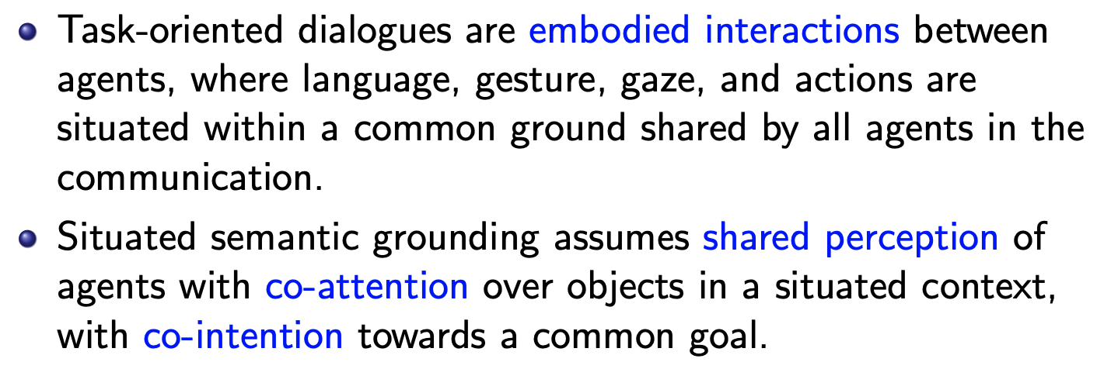
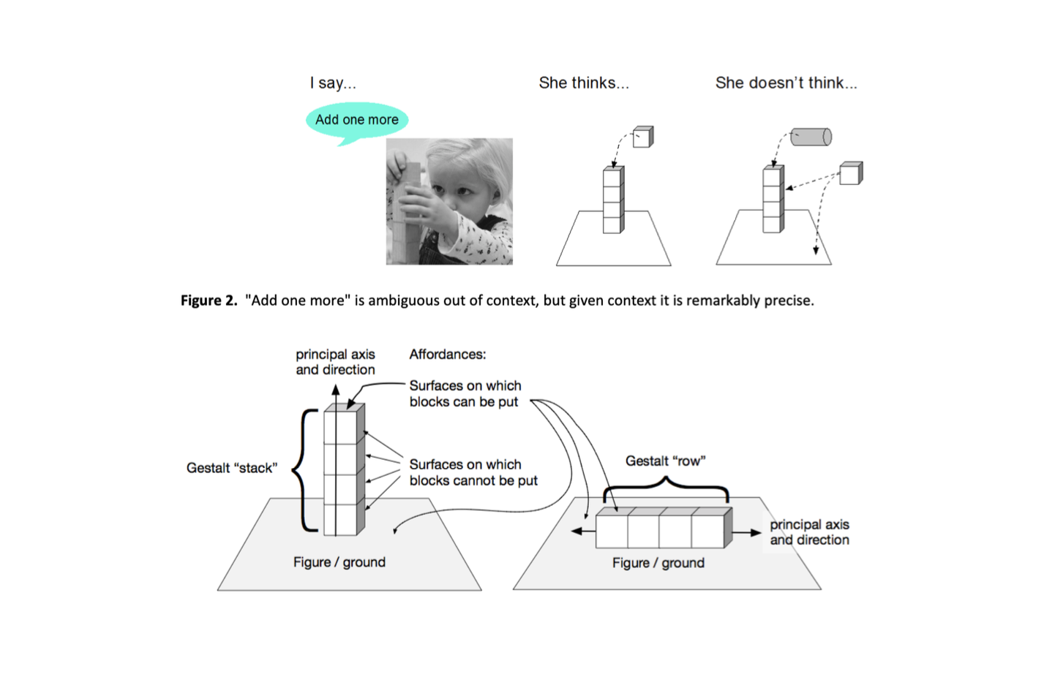
Dialogue, Context, and Situated Grounding
DARPA Communicating with Computers BAA - Paul Cohen, PM (2015)

Slide 5
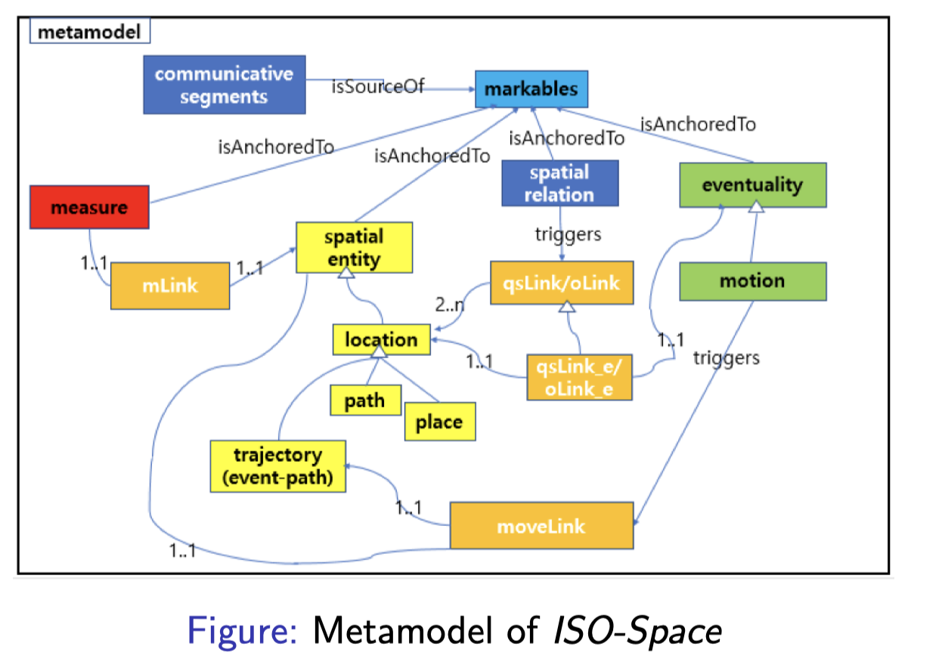
Semantics of ISO-Space
Pustejovsky, J. (2017). ISO-Space: Annotating static and dynamic spatial information.
In Handbook of linguistic annotation (pp. 989-1024). Springer, Dordrecht.

Slide 6
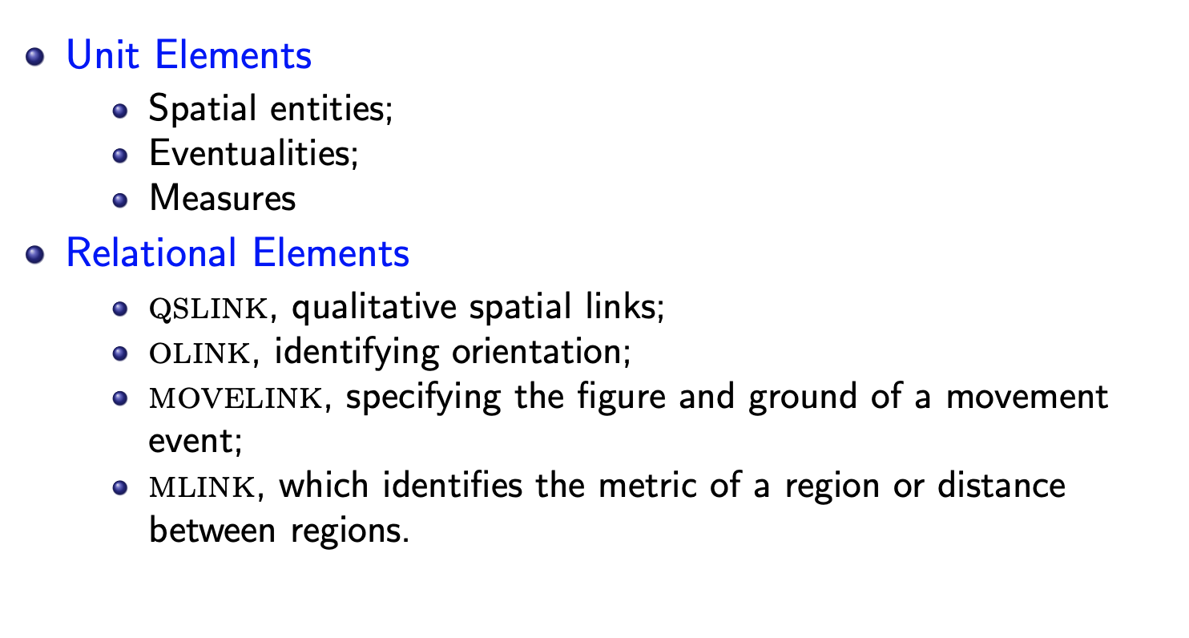
Unit Elements in ISO-Space

Slide 7
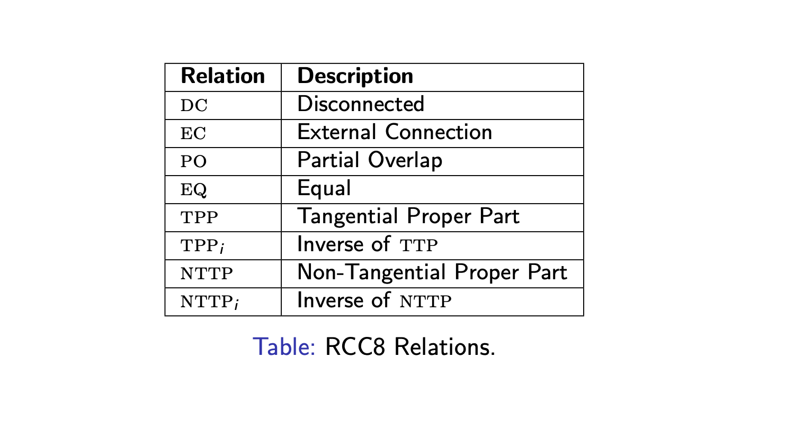
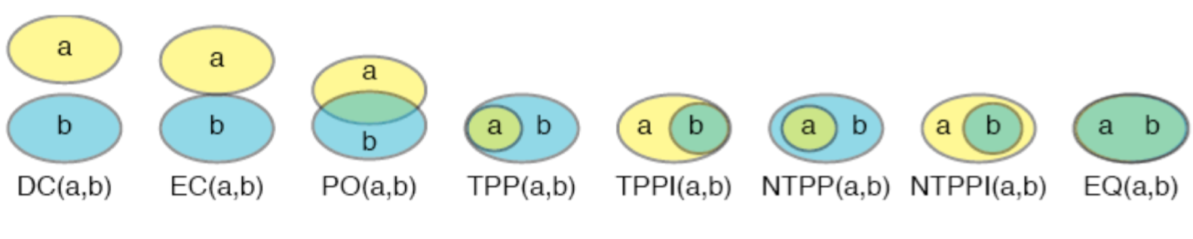
ISO-Space Qualitative Spatial Relations
Randell, D. A., Cui, Z., & Cohn, A. G. (1992). An interval logic for space based on “connection”. In Proceedings of the 10th European conference on Artificial intelligence (pp. 394-398).
Randell, D. A., Cui, Z., & Cohn, A. G. (1992). A spatial logic based on regions and connection. KR, 92, 165-176.

Slide 8
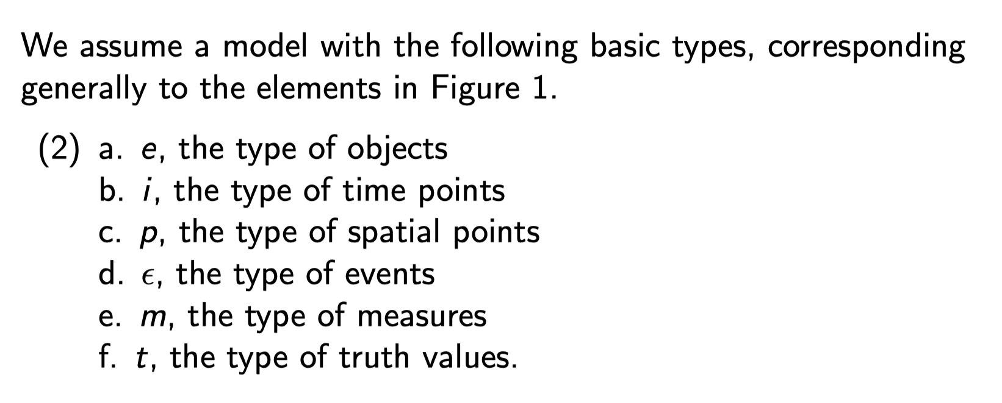
Basic Types and Type Operations

Slide 9
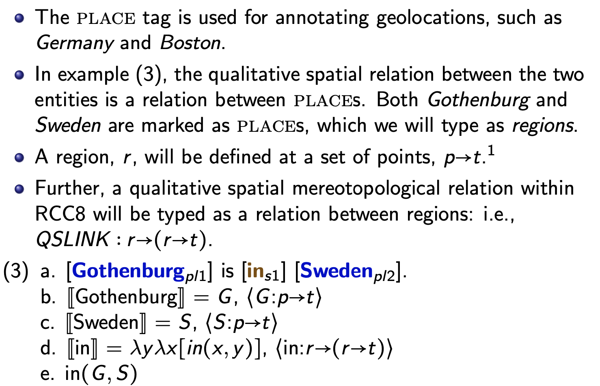
Place and Spatial Entity

Slide 10
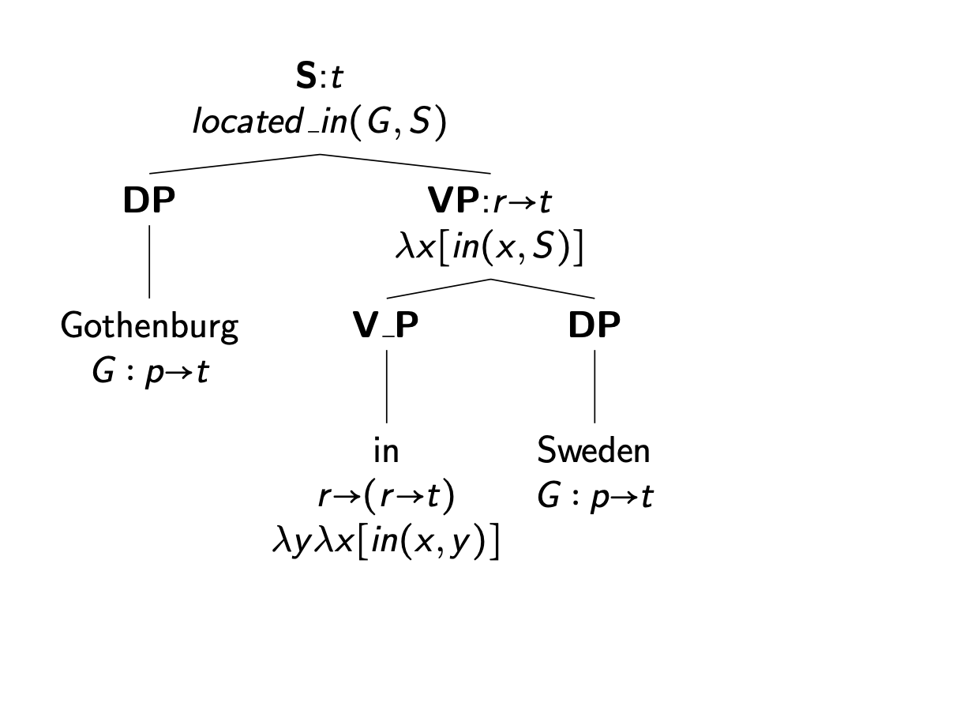
Spatial Composition in ISO-Space
Kracht, M. (2002). On the semantics of locatives. Linguistics and philosophy 25(2), 157–232.

Slide 11
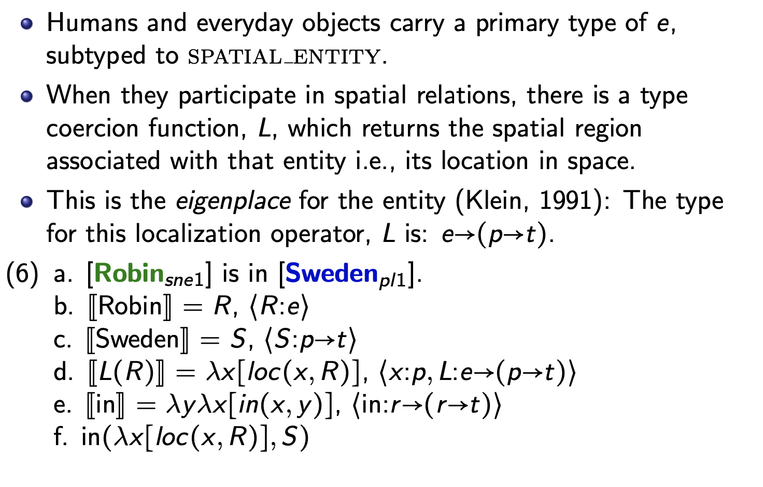
Eigenplace Function

Slide 12
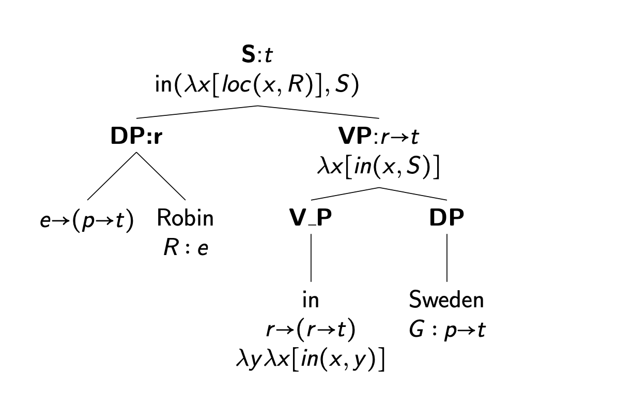
Eigenplace Coercion

Slide 13
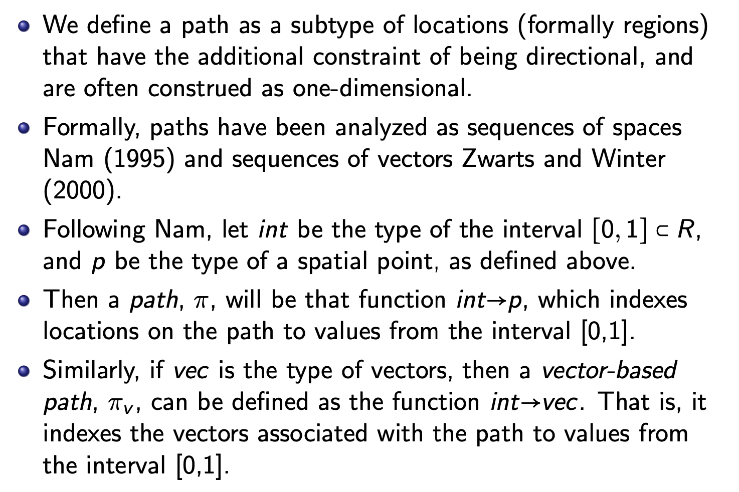
Paths in ISO-Space

Slide 14
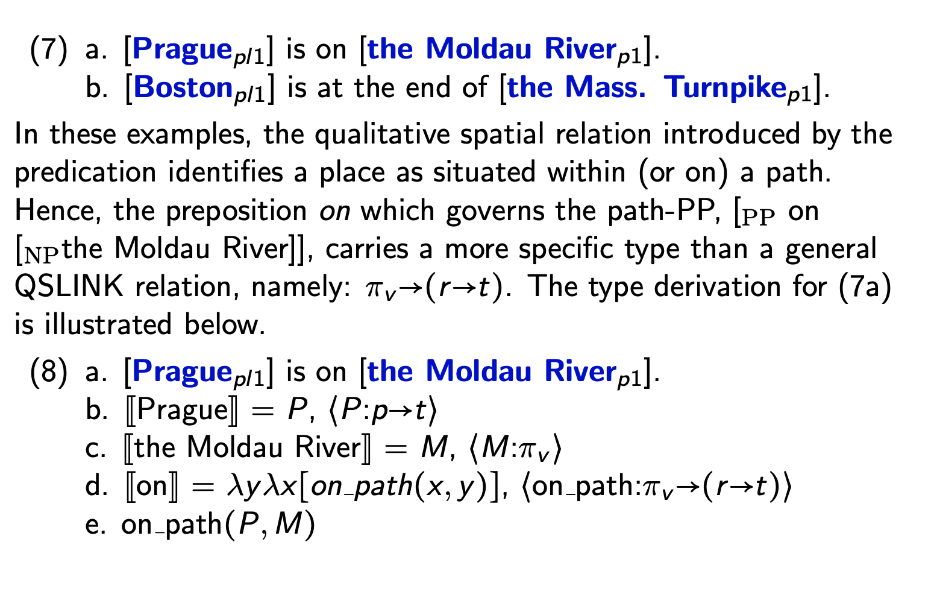
Path Interpretation

Slide 15
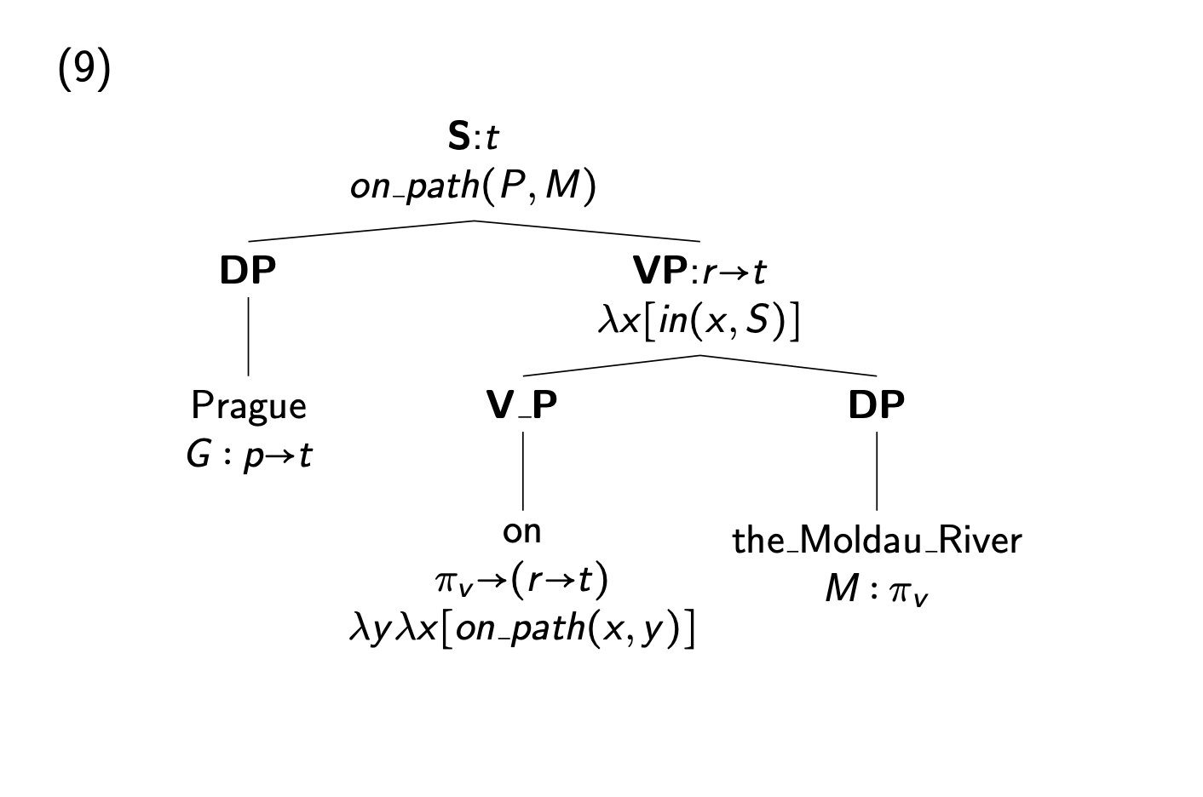
Path Interpretation
Mani I., Pustejovsky J., Interpreting Motion: Grounded Representations for Spatial Language, Oxford University Press, 2012.

Slide 16
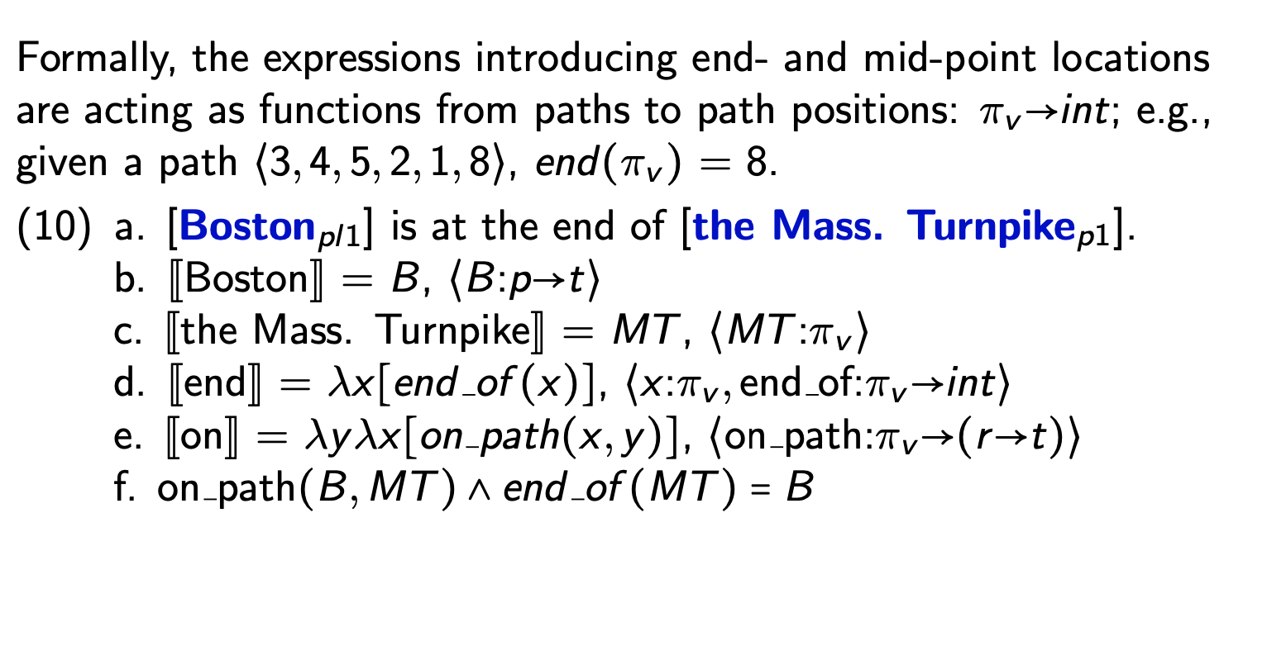
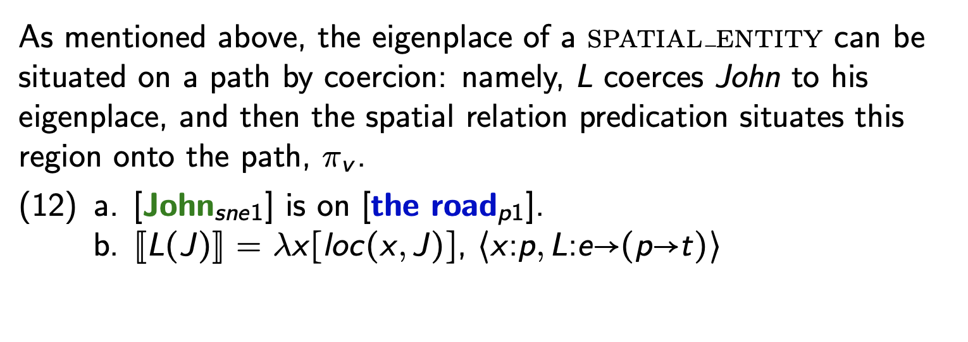
Path Interpretation

Slide 17
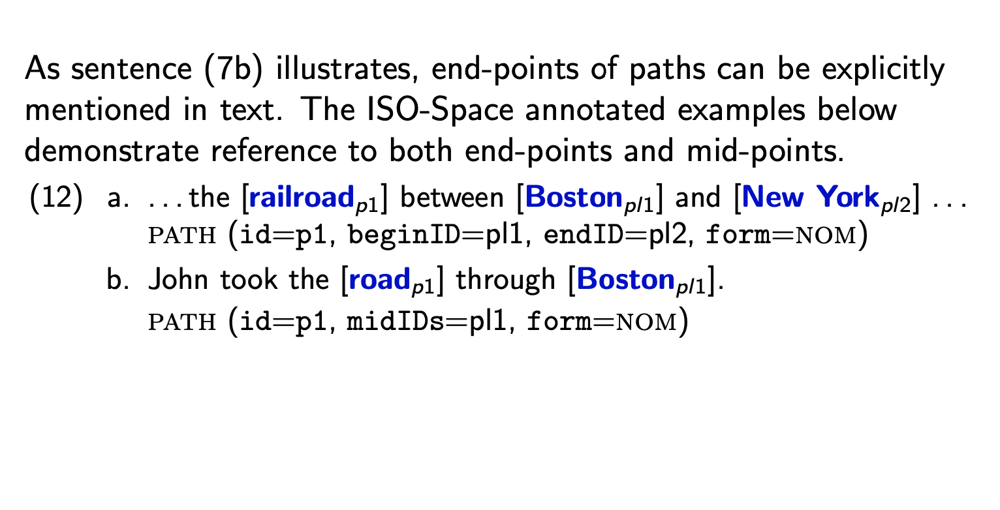
ISO-Space Annotation of Path

Slide 18
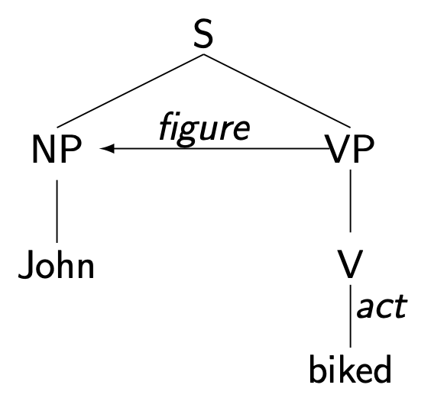
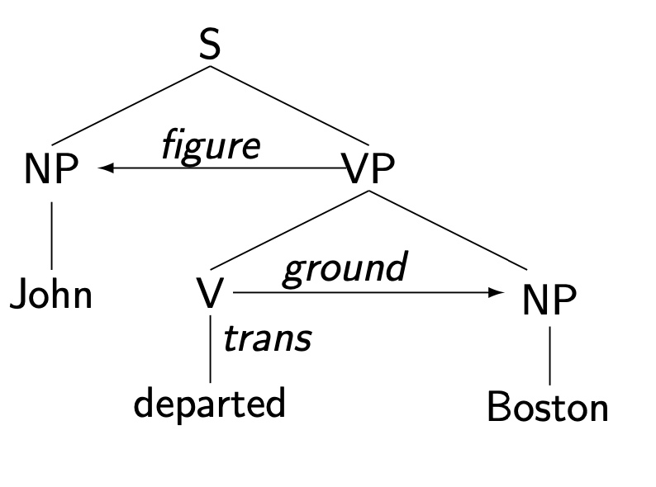
How Verbs Encode Paths
Languages have two strategies to convey movement of an object through space
Path Motion: John arrived at home.
Manner Motion: John walked.
Language encodes motion in Path and Manner constructions
Path: change with distinguished location
Manner: motion with no distinguished locations
Manner and paths may compose.

Slide 19
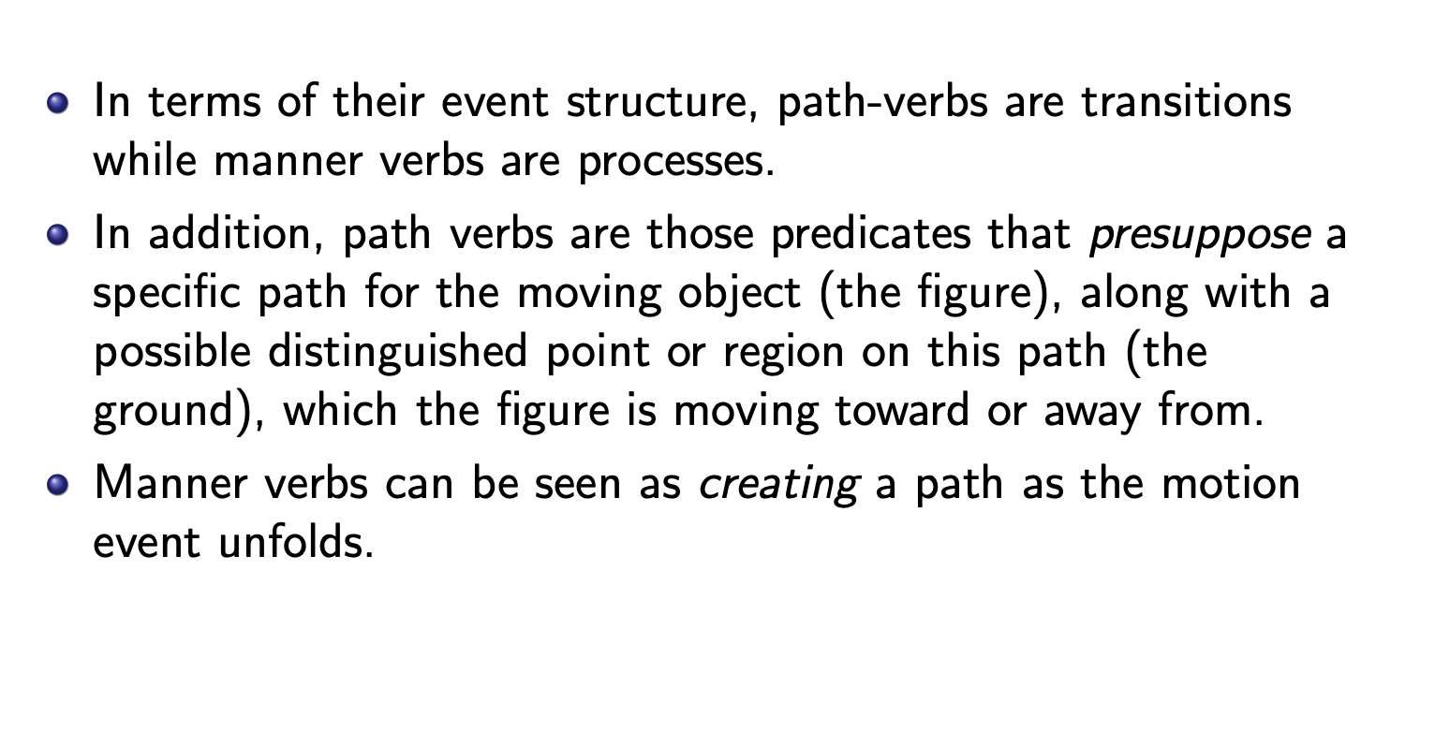
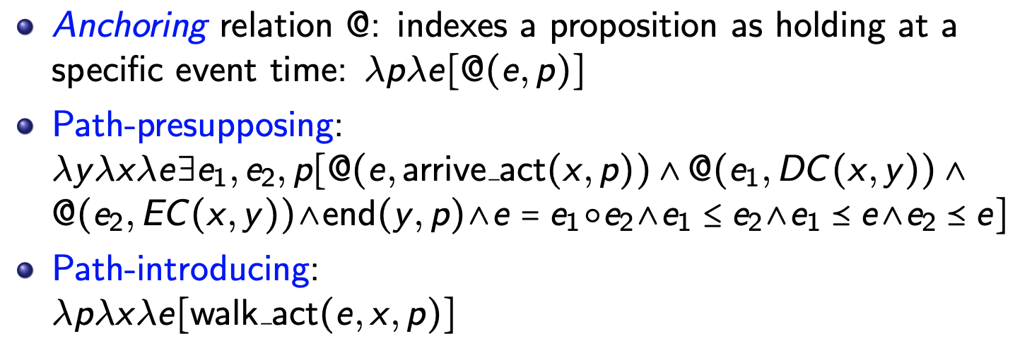
How Verbs Make Paths

Slide 20
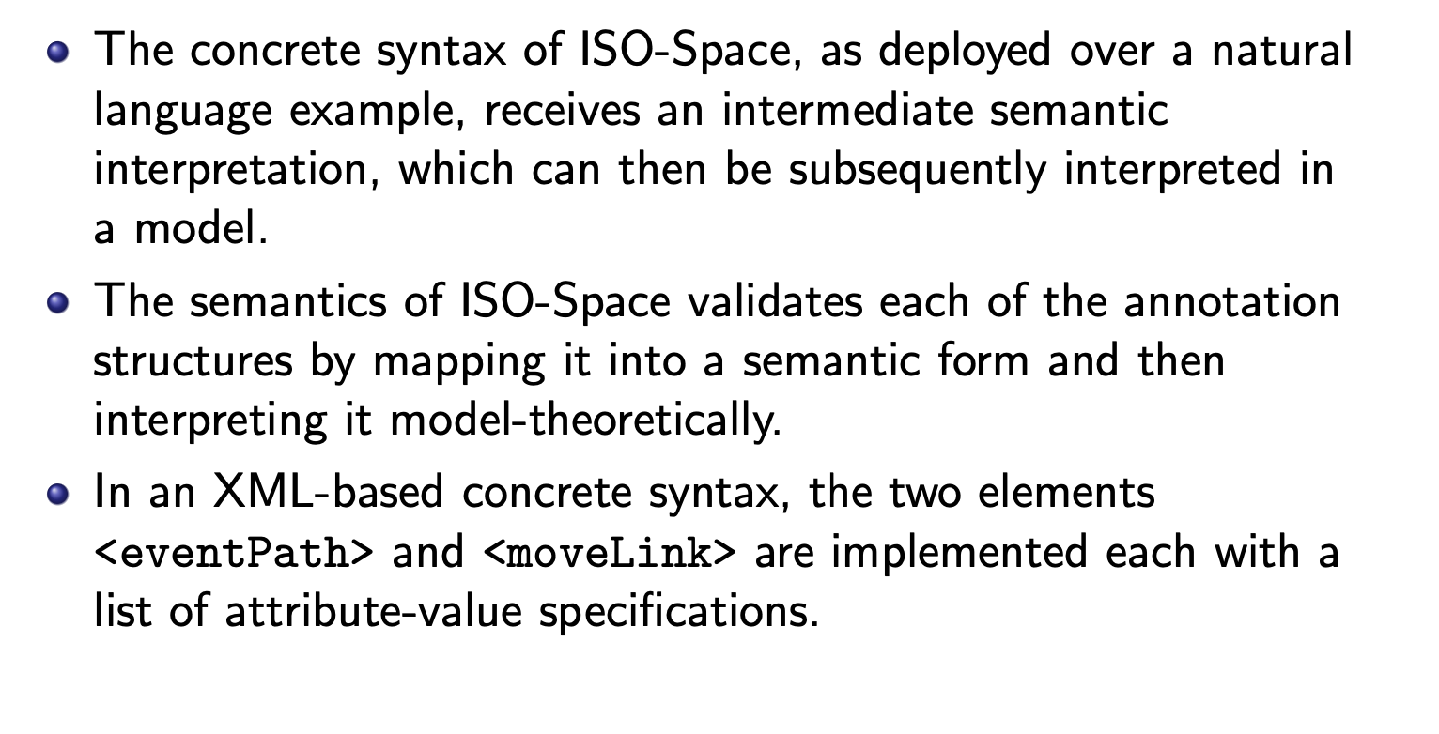
Reasoning with Paths

Slide 21
Temporally Anchored Paths in Text
David left San Cristobal de Las Casas 4 days ago.
David arrived in Ocosingo that day.
The next day, David biked to Agua Azul and played in the waterfalls there for 4 hours.
David spent the next day at the ruins of Palenque.
The following day, David drove to the border with Guatemala.
Pustejovsky, J., & Moszkowicz, J. L. (2011). The qualitative spatial dynamics of motion in language. Spatial Cognition & Computation, 11(1), 15-44.
Mani I., Pustejovsky J., Interpreting Motion: Grounded Representations for Spatial Language, Oxford University Press, 2012.
Pustejovsky, J., Moszkowicz, J. L., & Verhagen, M. (2011, January). ISO-Space: The annotation of spatial information in language. In Proceedings of the Sixth Joint ISO-ACL SIGSEM Workshop on Interoperable Semantic Annotation (Vol. 6, pp. 1-9).

Slide 22
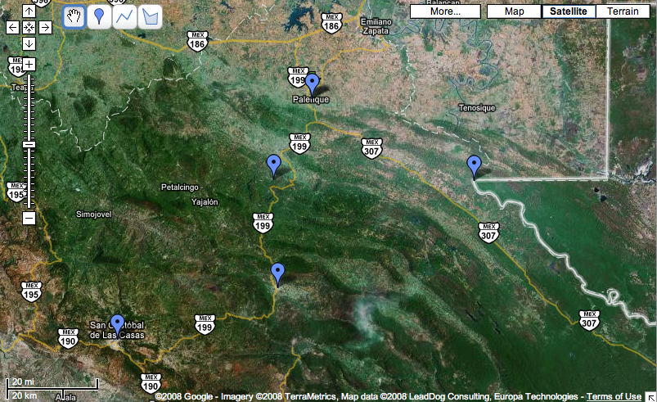
Ruins of Palenque
Agua Azul
Border with Guatemala
Leave(David, S.C., 20060303)
Ocosingo
San Cristobal de Las Casas
David left San Cristobal de Las Casas 4 days ago.

Slide 23
Ruins of Palenque
Agua Azul
Border with Guatemala
Arrive(David, Ocosingo, 20060303)
Ocosingo
San Cristobal de Las Casas
David arrived in Ocosingo that day.

Slide 24
Ruins of Palenque
Agua Azul
Border with Guatemala
Bike(David, to_Agua Azul, 20060304)
Ocosingo
San Cristobal de Las Casas
The next day, David biked to Agua Azul and played in the waterfalls there for 4 hours.

Slide 25
Ruins of Palenque
Agua Azul
Play(David, Agua Azul(waterfalls), P4H)
Border with Guatemala
Ocosingo
San Cristobal de Las Casas
The next day, David biked to Agua Azul and played in the waterfalls there for 4 hours.

Slide 26
Spend(David, Ruins, 20060305)
Ruins of Palenque
Agua Azul
Border with Guatemala
Ocosingo
San Cristobal de Las Casas
David spent the next day at the ruins of Palenque.

Slide 27
Ruins of Palenque
Drive(David, to_Border, 20060306)
Agua Azul
Border with Guatemala
Ocosingo
San Cristobal de Las Casas
The following day, David drove to the border with Guatemala.

Slide 28
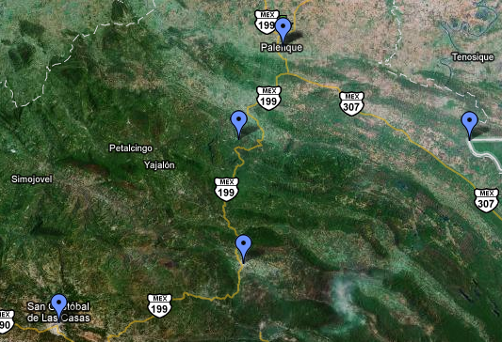
Ruins of Palenque
Agua Azul
Border with Guatemala
Ocosingo
San Cristobal de Las Casas
March 3, 2006
David left San Cristobal de Las Casas 4 days ago.
David arrived in Ocosingo that day.
The next day, David biked to Agua Azul and played in the waterfalls there for 4 hours.
David spent the next day at the ruins of Palenque.
The following day, David drove to the border with Guatemala.

Slide 29
Ruins of Palenque
Agua Azul
Border with Guatemala
Ocosingo
March 3, 2006
San Cristobal de Las Casas
David left San Cristobal de Las Casas 4 days ago.
David arrived in Ocosingo that day.
The next day, David biked to Agua Azul and played in the waterfalls there for 4 hours.
David spent the next day at the ruins of Palenque.
The following day, David drove to the border with Guatemala.

Slide 30
Ruins of Palenque
Agua Azul
Border with Guatemala
March 4, 2006
Ocosingo
San Cristobal de Las Casas
David left San Cristobal de Las Casas 4 days ago.
David arrived in Ocosingo that day.
The next day, David biked to Agua Azul and played in the waterfalls there for 4 hours.
David spent the next day at the ruins of Palenque.
The following day, David drove to the border with Guatemala.

Slide 31
Ruins of Palenque
Agua Azul
4 hours on
March 4, 2006
Border with Guatemala
Ocosingo
San Cristobal de Las Casas
David left San Cristobal de Las Casas 4 days ago.
David arrived in Ocosingo that day.
The next day, David biked to Agua Azul and played in the waterfalls there for 4 hours.
David spent the next day at the ruins of Palenque.
The following day, David drove to the border with Guatemala.

Slide 32
Ruins of Palenque
March 5, 2006
Agua Azul
Border with Guatemala
Ocosingo
San Cristobal de Las Casas
David left San Cristobal de Las Casas 4 days ago.
David arrived in Ocosingo that day.
The next day, David biked to Agua Azul and played in the waterfalls there for 4 hours.
David spent the next day at the ruins of Palenque.
The following day, David drove to the border with Guatemala.

Slide 33
Ruins of Palenque
March 6, 2006
Agua Azul
Border with Guatemala
Ocosingo
San Cristobal de Las Casas
David left San Cristobal de Las Casas 4 days ago.
David arrived in Ocosingo that day.
The next day, David biked to Agua Azul and played in the waterfalls there for 4 hours.
David spent the next day at the ruins of Palenque.
The following day, David drove to the border with Guatemala.

Slide 34
Different Tasks - Different Spatial Representations
Textual-based inferences can employ lexical resources (VerbNet, VerbAtlas), annotated datasets (ISO-Space, SpRL), as well as architectures that enable multimodal embeddings with aligned image-caption pairs.
Situated dialogue and HRI tasks cannot so readily rely on these solutions.
Real HHI, HCI, and HRI require a model of how the agents are embodied in the interaction …
As well as an understanding of how objects under discussion are situated and grounded.

Slide 35
Creating Semantic Datasets is Costly
But….
If we can leverage existing lexical resources;
And train algorithms to assign semantic types to textual corpora;
We can fine-tune Language Models to perform task-specific semantic inference, through prompt-based learning.
Namely, spatial reasoning.
Brown, Susan Windisch, et al. "Semantic Representations for NLP Using VerbNet and the Generative Lexicon." Frontiers in artificial intelligence 5 (2022).

Slide 36
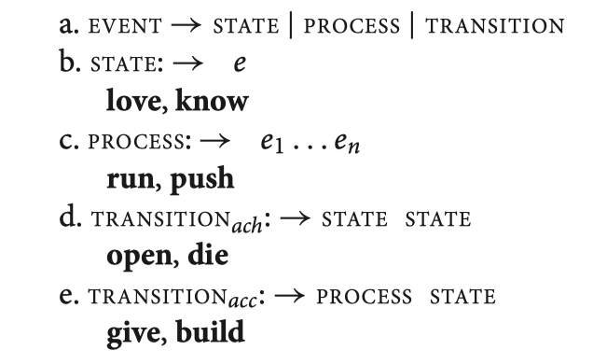
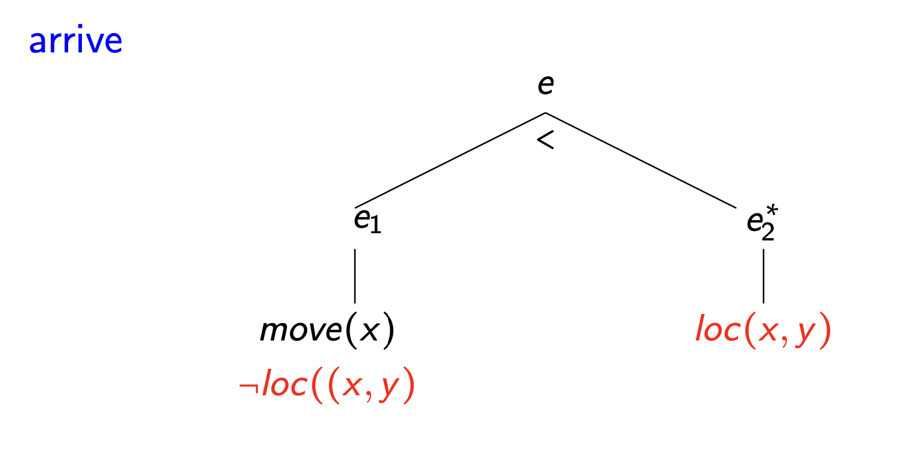
Generative Lexicon Event Structure

Slide 37
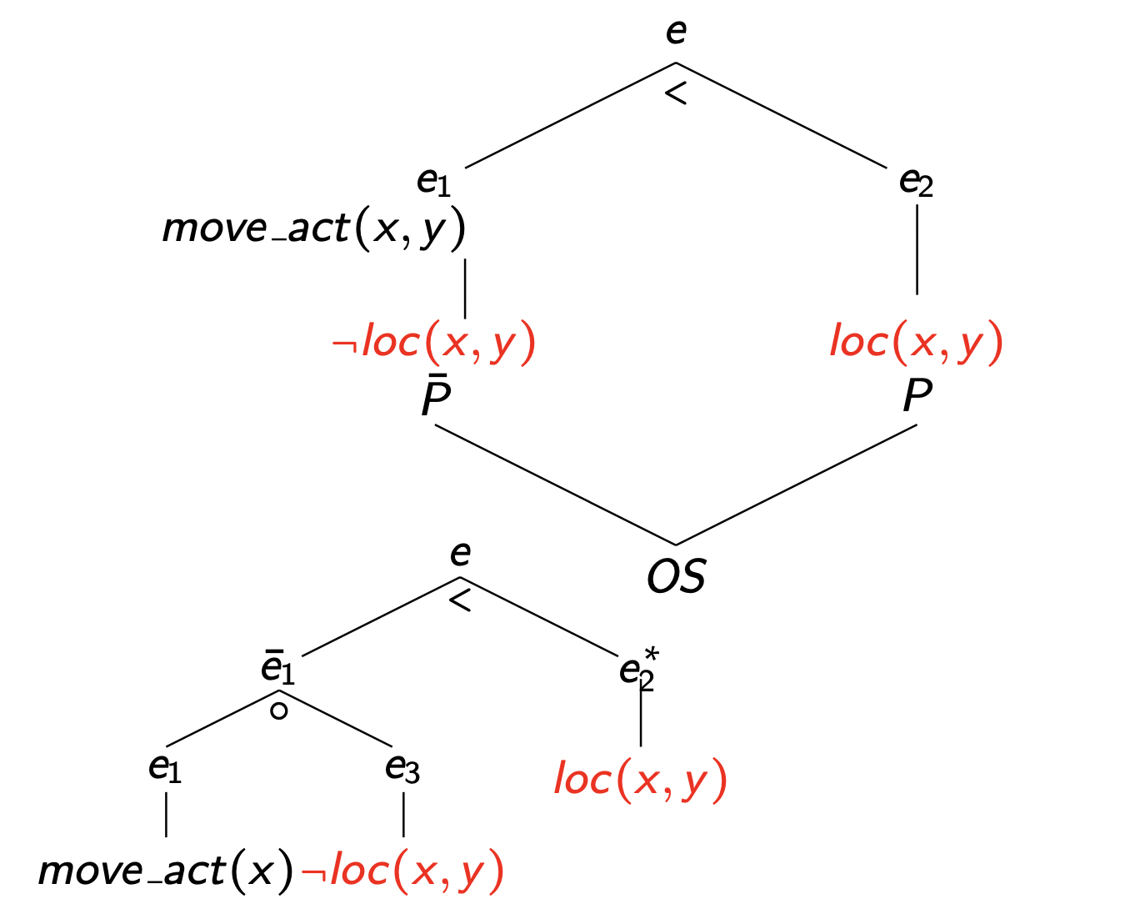
Event Tree with Spatial Opposition
arrive

Slide 38
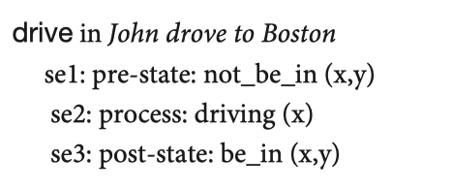
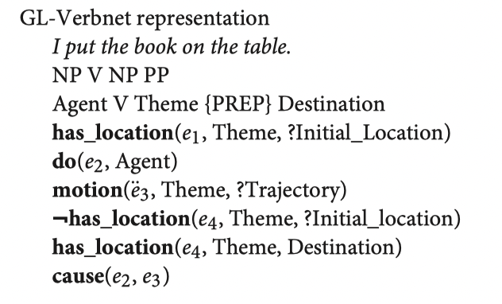
Event Structure → GL-VerbNet
GL Event Structure
Im (2014)
GL-VerbNet –
Pustejovsky et al (2017), Brown et al (2018, 2022)

Slide 39
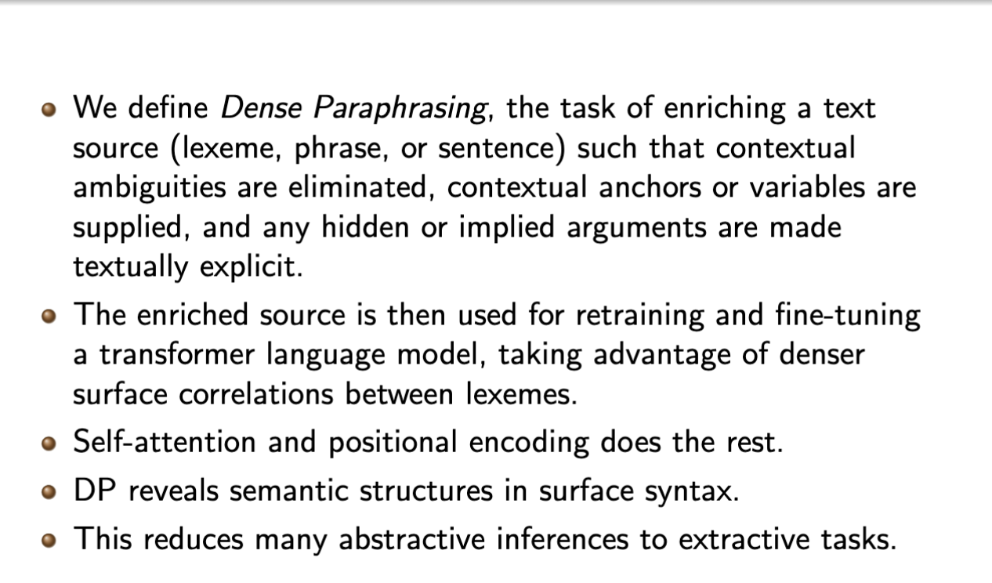
Dense Paraphrasing
Tu, Rim, and Pustejovsky (2022a, 2022b)

Slide 40
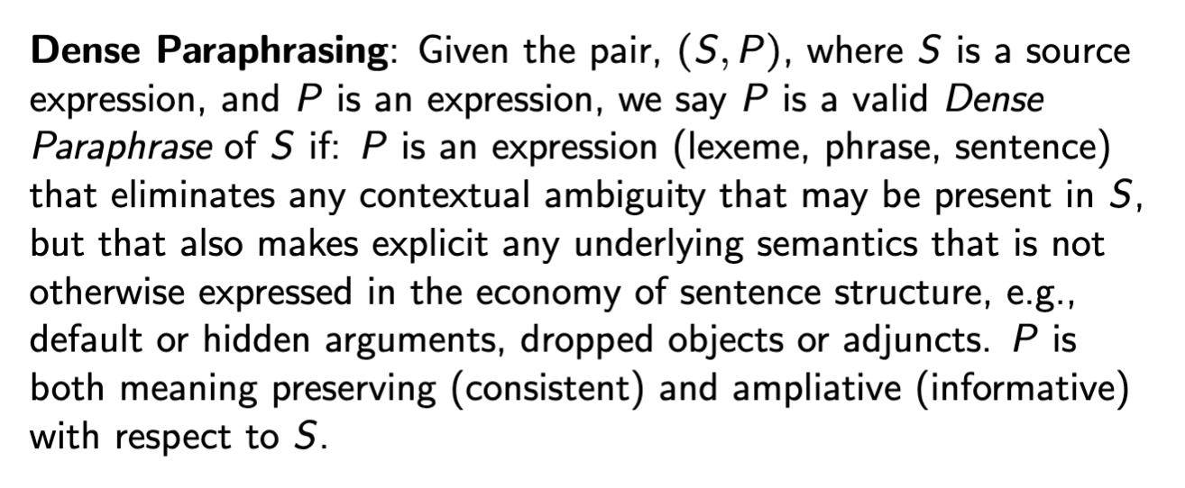
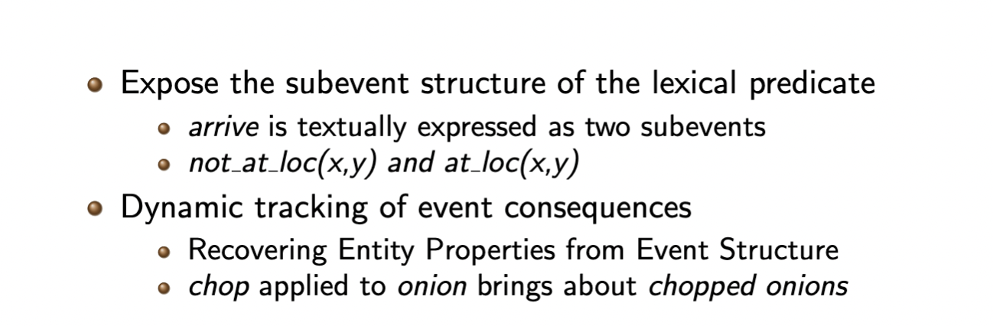
Dense Paraphrasing

Slide 41
Dense Paraphrasing
We define DP as an approach to:
Decontextualize the expression by filling in lexical frames
Enrich the textual description to reflect the changes in the object (from dynamic event structure)
Tag event with its subevent structure that involves the begin and end of an event
Define two types of event end state (common in recipe text)
TRANSFORMATION
LOCATION-CHANGE
Paraphrase the transformation end state of object
object → pastParticipleVerb + object

Slide 42
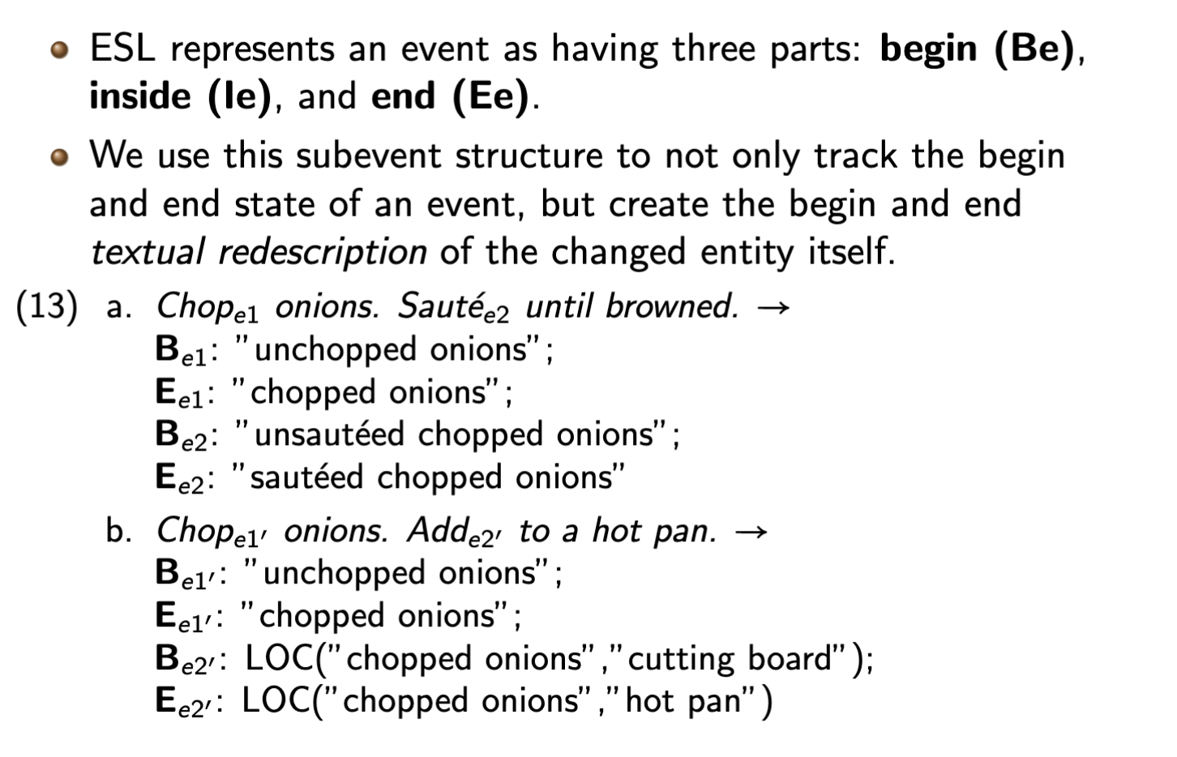
Recovering Entity Properties from Event Structure

Slide 43
Spatial Paraphrasing through Event Structure
Pour sauce on chicken.
B_e1: not_on(sauce,chicken) “the sauce is not on the chicken”
E_e1: on(sauce,chicken) “the sauce is on the chicken”
Put the pizza in the oven.
B_e1: not_in(pizza,oven) “the pizza is not in the oven”
E_e1: in(pizza,oven) “the pizza is in the oven”
Mary left the house.
B_e1: in(mary,house) “Mary is in the house”
E_e1: not_in(mary,house) “Mary is not in the house/outside the house”

Slide 44
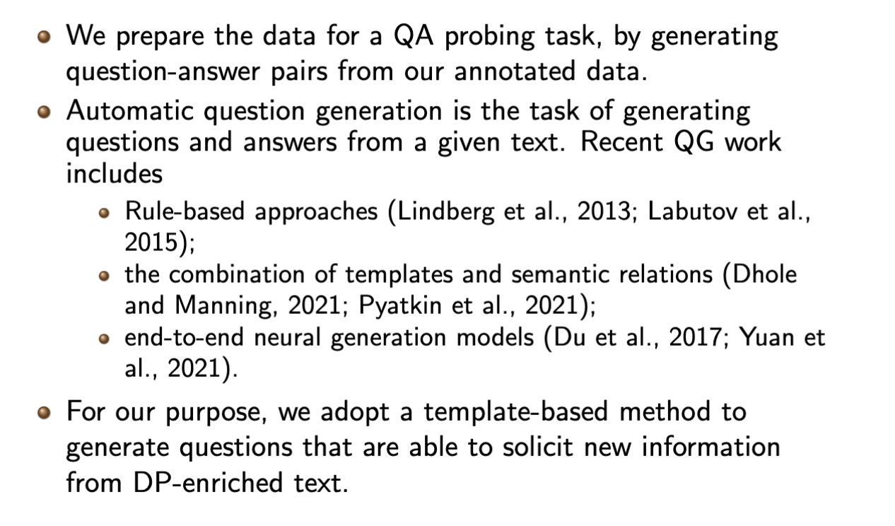
Question Answering on DP Questions

Slide 45
Dense Paraphrasing as Text Generation Task
We apply the T5 text generation model on the raw recipe text and let it generate output text as Dense Paraphrases.
Tu, Rim, and Pustejovsky (2022b) “Dense Paraphrasing for Textual Enrichment” arXiv.

Slide 46
Situated Grounding and Spatial Reasoning
Multimodal Situated Grounding – co-perception and co-attention are necessary to understand deixis and relative spatial expressions
Put the big one right here.
I want the cookie on the left behind the donut.
Show me a coffee shop around … here.
Understanding Events and their Results – actions change the spatial nature of the environment
Mary opened the door and left the room.
Put the book in the bag. Take the bag to the car.
Remove the seeds and cut into thin strips, then brown in oil.
Appreciation of spatial properties of objects - intrinsic vs. relative Frame of Reference
The tree behind the bench
The bench in front of the tree

Slide 47
Situated Grounding – Foundational Work
Cassell, J., Nakano, Y., Reinstein, G., & Stocky, T. (2003). Towards a model of face-to-face grounding. ACL.
Holroyd, A., Rich, C., Sidner, C. L., & Ponsler, B. (2011). Generating connection events for human-robot collaboration. 2011 RO-MAN, IEEE.
Traum, D., and Rickel, J. (2002). Embodied agents for multi-party dialogue in immersive virtual worlds. Proc. Autonomous agents and multiagent systems.
Scheutz, M., Schermerhorn, P., Kramer, J., & Anderson, D. (2007). First steps toward natural human-like HRI. Autonomous Robots, 22(4).
Elliott, D., D. Kiela and A. Lazaridou (2016) Multimodal Learning and Reasoning, ACL Tutorial.
Yatskar, M., Zettlemoyer, L., and Farhadi, A. (2016). Situation recognition: Visual semantic role labeling for image understanding. Proceedings of the IEEE CVPR.
Hough, J., & Schlangen, D. (2017). A Model of Continuous Intention Grounding for HRI.
Alikhani, M., and Stone, M. (2020). Achieving Common Ground in Multi-modal Dialogue. In Proceedings of the 58th Annual Meeting of ACL Tutorial
Loáiciga, Sharid, Simon Dobnik, and David Schlangen. "Anaphoric Phenomena in Situated Dialog: A First Round of Annotations." In Proceedings of the Fourth Workshop on Computational Models of Reference, Anaphora and Coreference, pp. 31-37. 2022.
Pustejovsky, J. and Krishnaswamy, N., 2022. Multimodal Semantics for Affordances and Actions. In International Conference on Human-Computer Interaction (pp. 137-160). Springer.

Slide 48
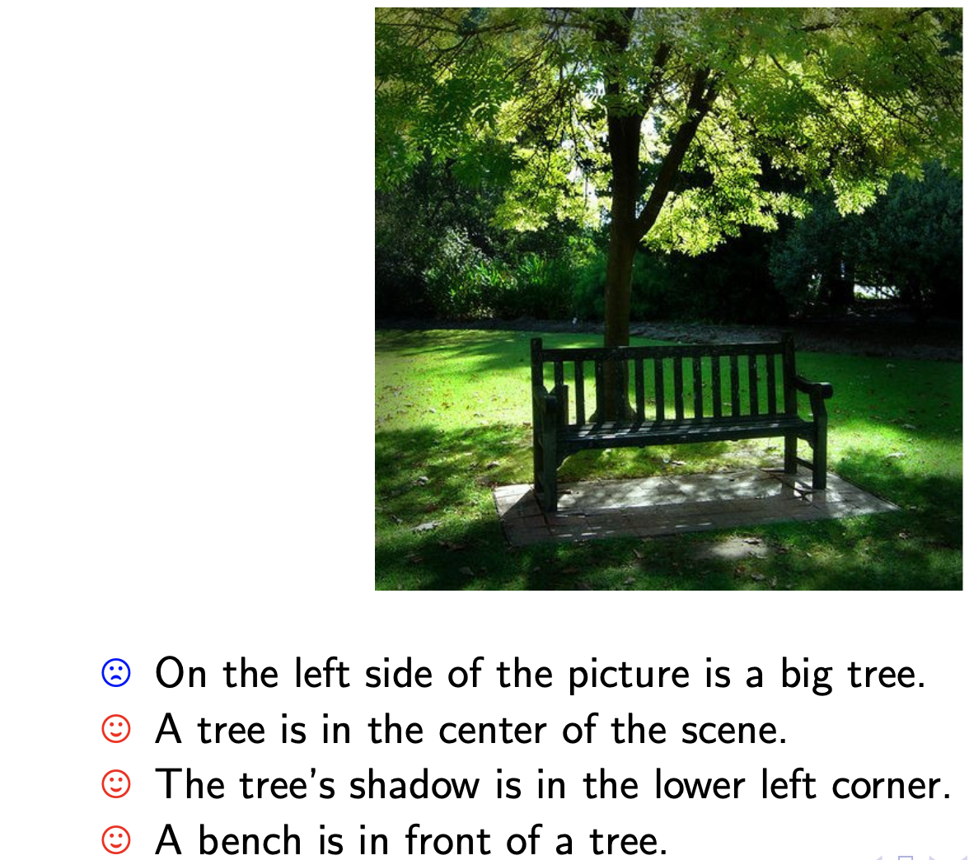
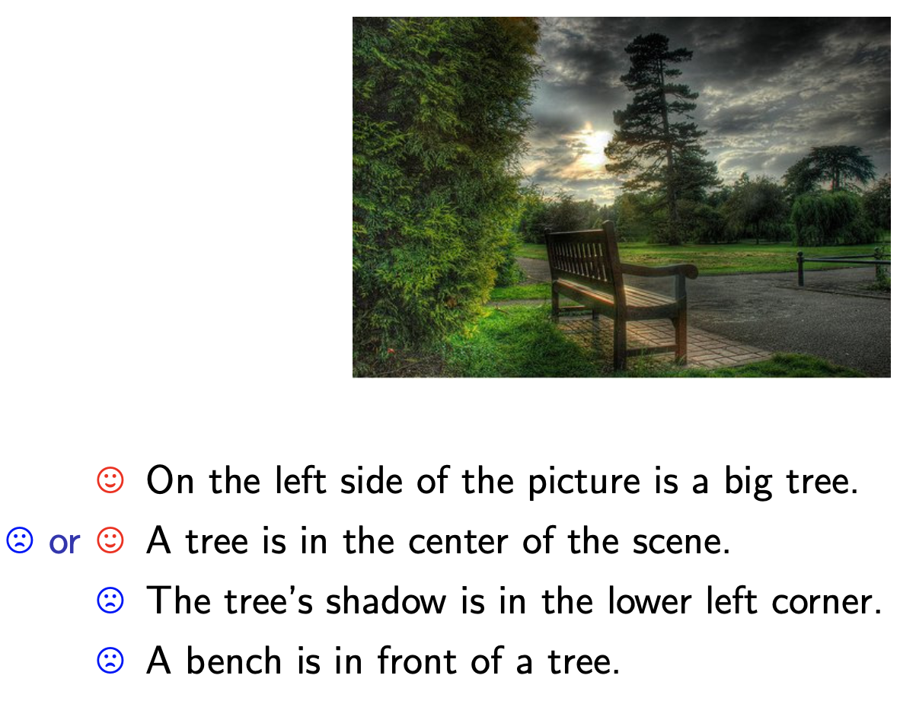
Situated Grounding and Spatial Reasoning
Frames of Reference
Absolute (coordinate system)
Relative (from an agent view)
Intrinsic (inherent property of object)
Levinson, S. C. (2003). Space in language and culture: Explorations in cognitive diversity. Cambridge: Cambridge University Press

Slide 49
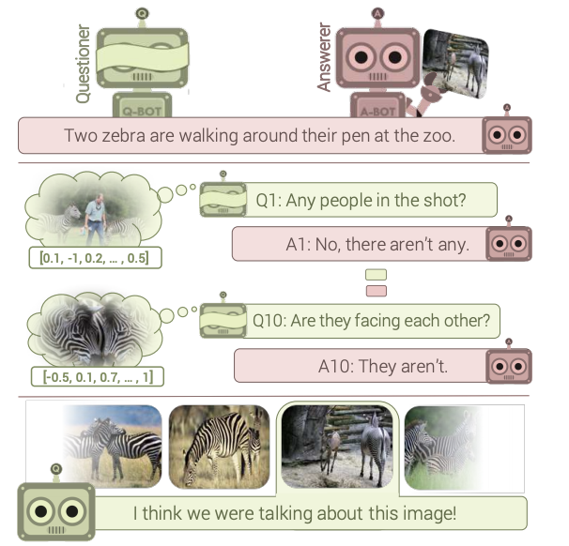
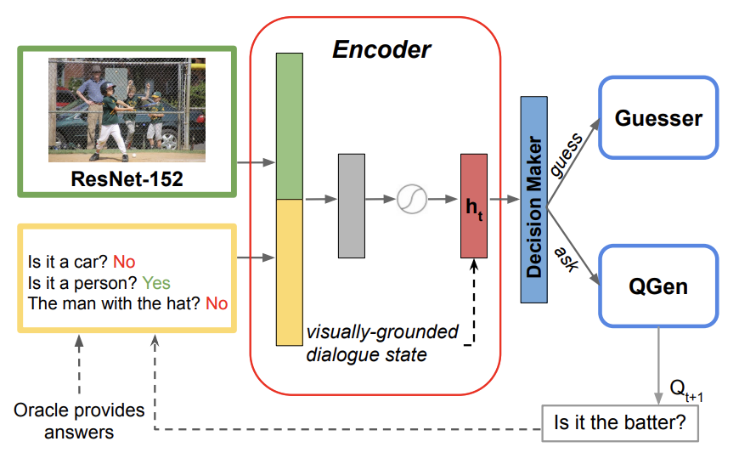
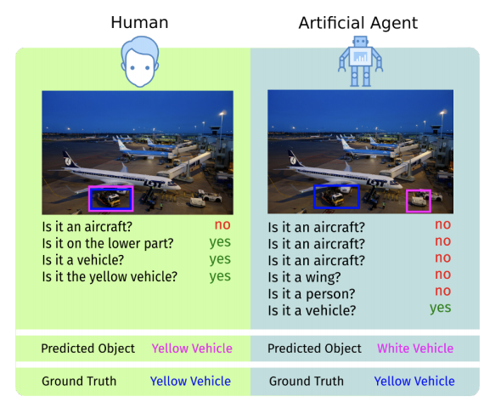
Interactive Object Recognition in Dialogue
Das, A., Kottur, S., Moura, J. M., Lee, S., & Batra, D. (2017). Learning cooperative visual dialog agents with deep reinforcement learning. In Proceedings of the IEEE international conference on computer vision (pp. 2951-2960).
Shekhar, R., Testoni, A., Fernández, R., & Bernardi, R. (2019). Jointly Learning to See, Ask, Decide when to Stop, and then GuessWhat. In CLiC-it.
Shukla, P., Elmadjian, C., Sharan, R., Kulkarni, V., Turk, M., & Wang, W. Y. (2019). What Should I Ask? Using Conversationally Informative Rewards for Goal-Oriented Visual Dialog. arXiv preprint arXiv:1907.12021.

Slide 50
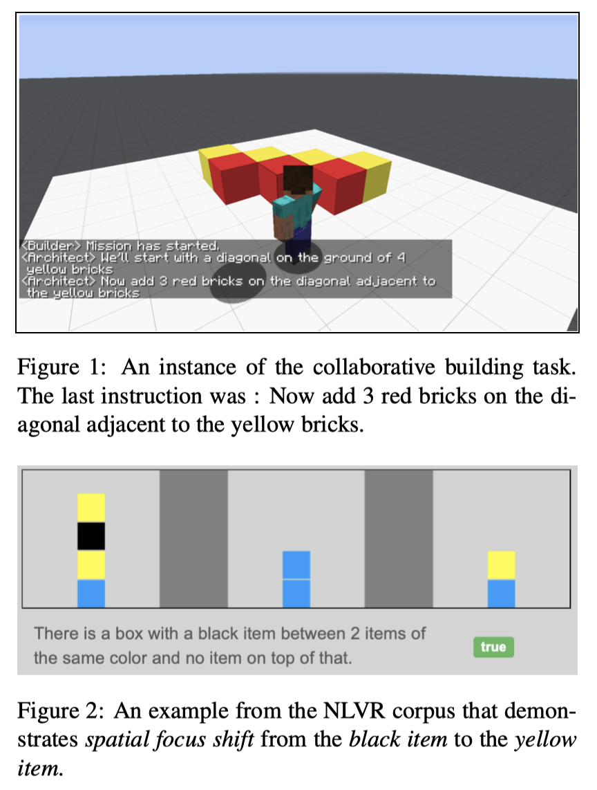
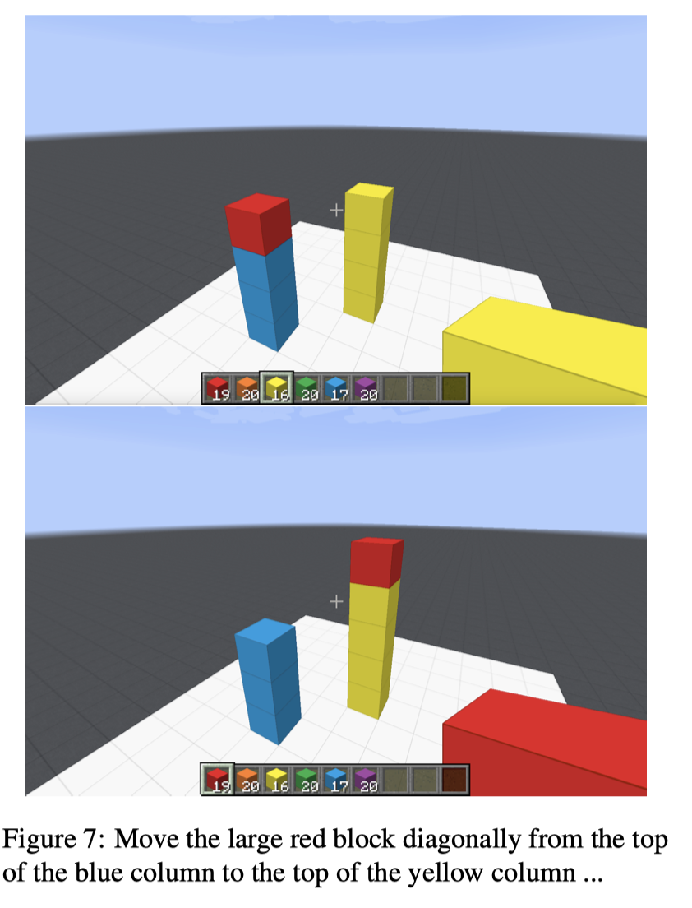
Spatial Reasoning in Collaborative Tasks
Dan, S., Kordjamshidi, P., Bonn, J., Bhatia, A., Cai, Z., Palmer, M., & Roth, D. (2020). From Spatial Relations to Spatial Configurations. Proceedings of The 12th Language Resources and Evaluation Conference (pp. 5855-5864).

Slide 51
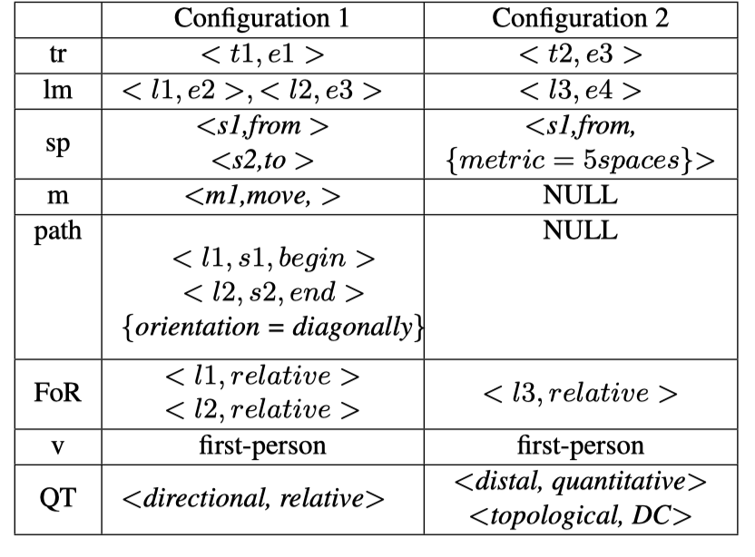
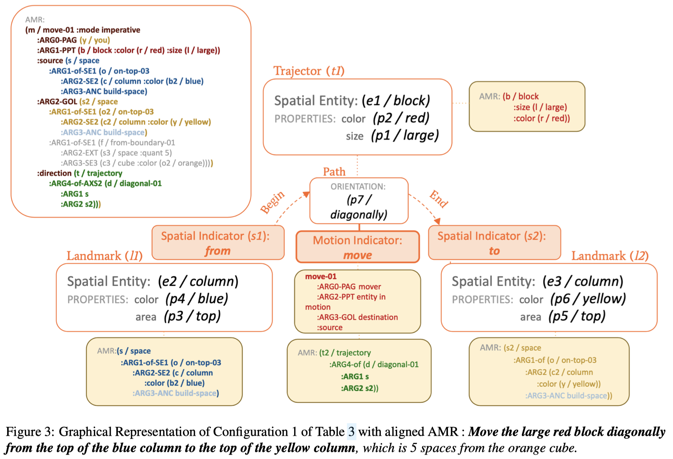
Spatial Reasoning and AMRs
Dan, S., Kordjamshidi, P., Bonn, J., Bhatia, A., Cai, Z., Palmer, M., & Roth, D. (2020). From Spatial Relations to Spatial Configurations. Proceedings of The 12th Language Resources and Evaluation Conference (pp. 5855-5864).

Slide 52
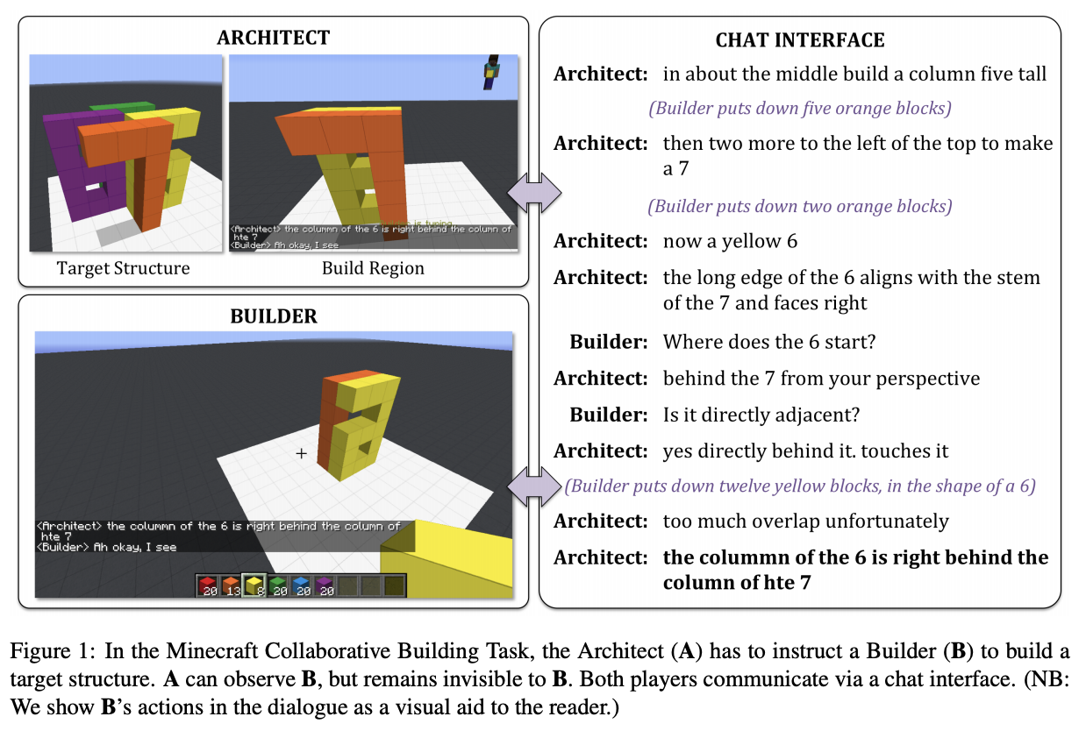
Spatial Reasoning in Minecraft
Create models that generate spatial descriptions
Narayan-Chen, A., Jayannavar, P., & Hockenmaier, J. (2019). Collaborative dialogue in Minecraft. In Proceedings of the 57th Annual Meeting of the Association for Computational Linguistics (pp. 5405-5415).

Slide 53
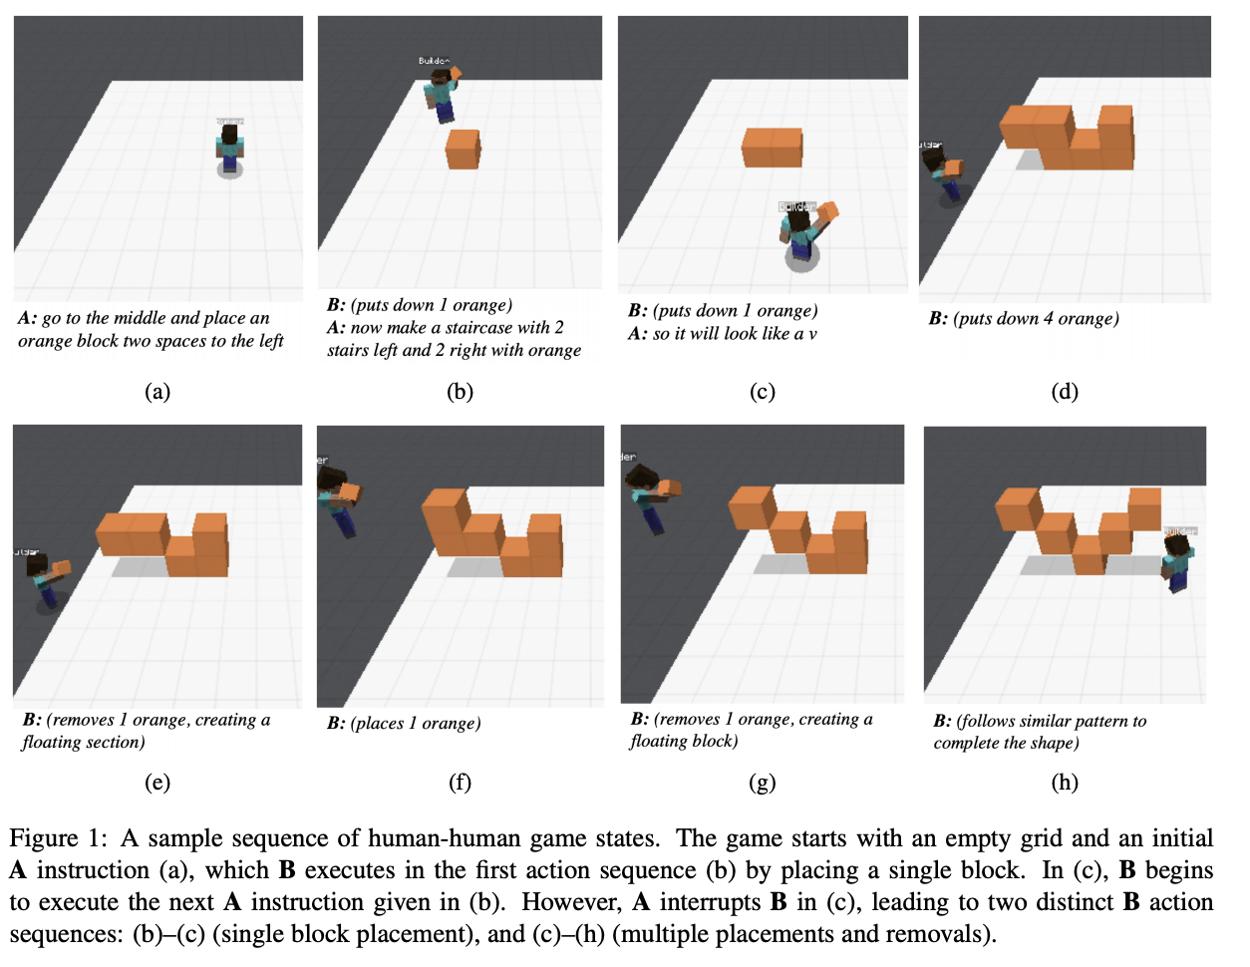
Spatial Reasoning in Minecraft
Create models that execute spatial actions
Jayannavar, P., Narayan-Chen, A., & Hockenmaier, J. (2020). Learning to execute instructions in a Minecraft dialogue. In Proceedings of the 58th Meeting of the Association for Computational Linguistics (pp. 2589-2602).

Slide 54
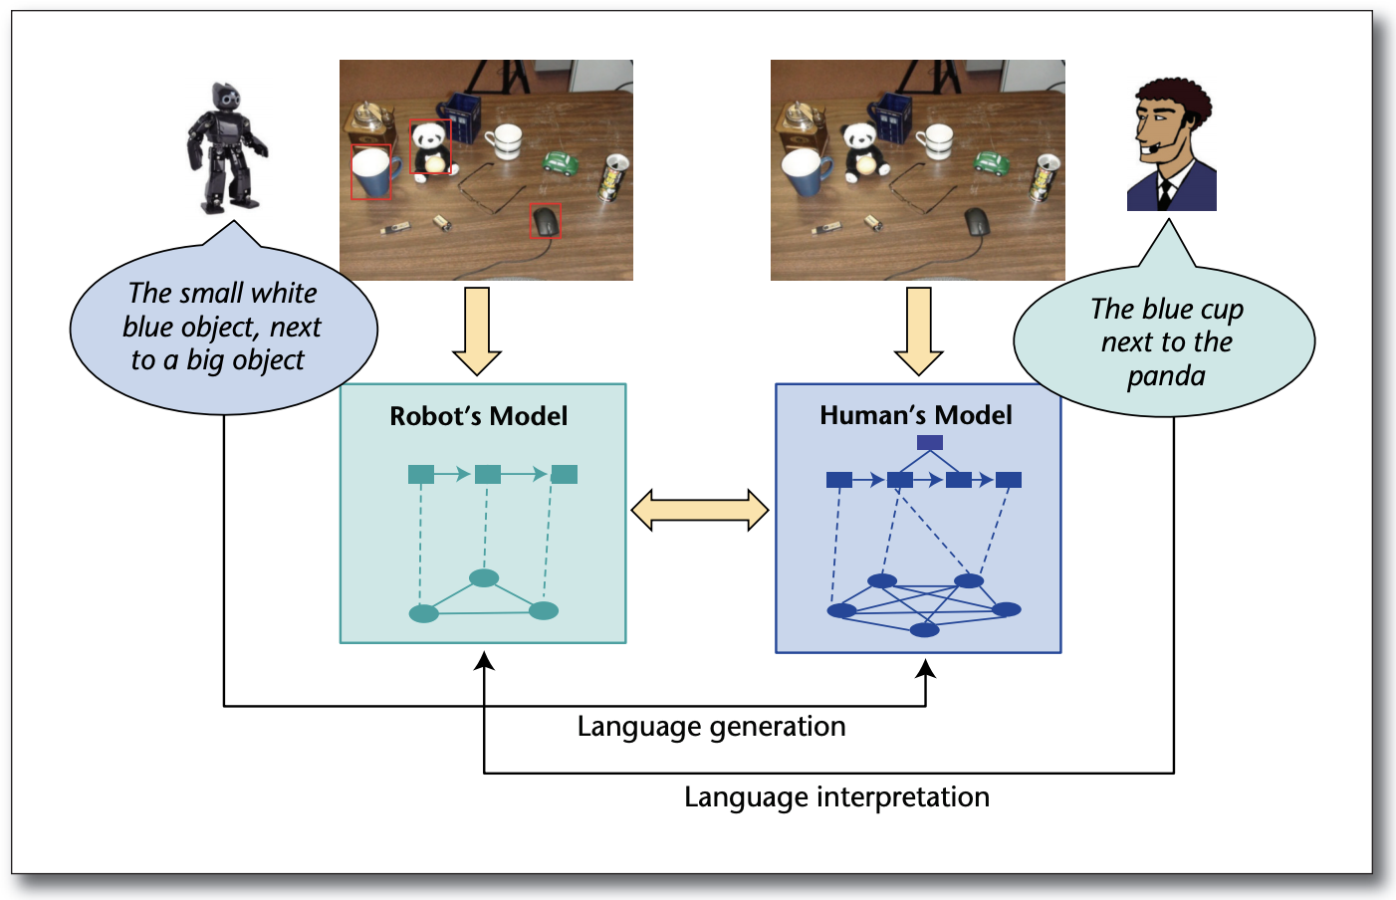
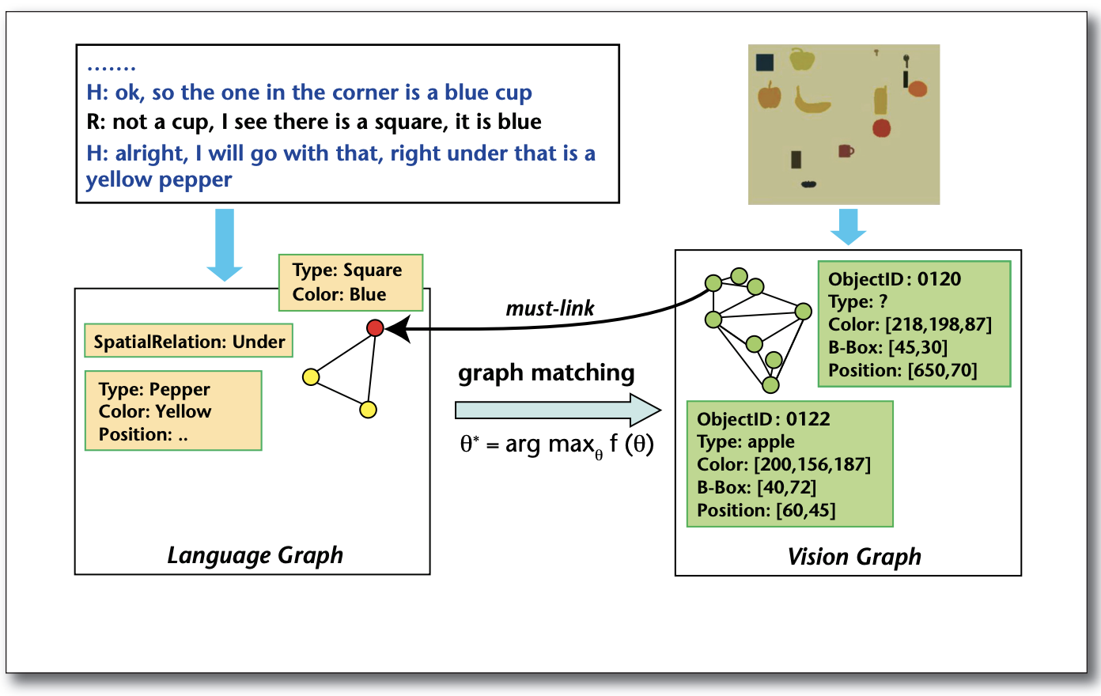
Situated Grounding in Human Robot Dialogue
Establish a Joint Perceptual Basis through language grounding
Chai, J. Y., Fang, R., Liu, C., & She, L. (2016). Collaborative language grounding toward situated human-robot dialogue. AI Magazine, 37(4), 32-45.
Graph-Matching for Interpreting Referring Expressions

Slide 55
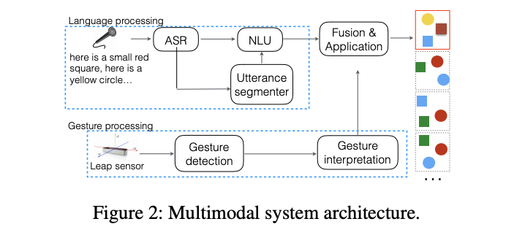
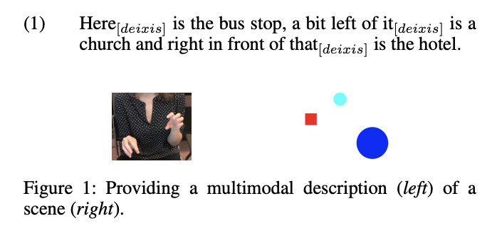
Grounding - Multimodal Spatial Expressions
Interpreting multimodal spatial descriptions in route giving tasks.
Gestures not only contribute information, but also help interpretations of speech incrementally, due to its parallel nature.
Han, T., Kennington, C., & Schlangen, D. (2018). Placing Objects in Gesture Space: Toward Real-Time Understanding of Spatial Descriptions. In AAAI18.

Slide 56
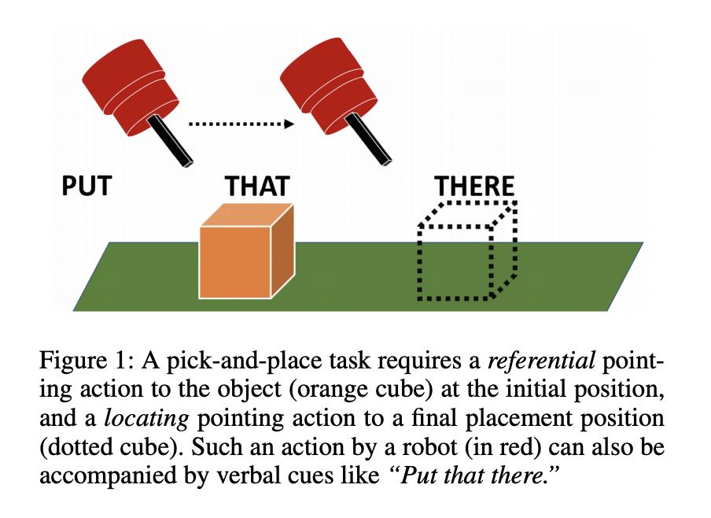

Situated Grounding and Pointing Actions
Pointing to something vs. somewhere
Human subjects show greater flexibility in interpreting the intent of referential pointing compared to locating pointing, which needs to be more deliberate.
Alikhani, M., Khalid, B., Shome, R., Mitash, C., Bekris, K. E., & Stone, M. (2020). That and There: Judging the Intent of Pointing Actions with Robotic Arms. In AAAI (pp. 10343-10351).

Slide 57

Components of Multimodal Interactions
Aspects of spatial reasoning in multimodal interactions

Slide 58

Spatial Reasoning and Situated Meaning
Pustejovsky, James, and Nikhil Krishnaswamy. "Multimodal Semantics for Affordances and Actions." In International Conference on Human-Computer Interaction, pp. 137-160. Springer, 2022.

Slide 59

Situated Meaning and Common Ground
Stalnaker R., “Common ground”, Linguistics and philosophy, vol. 25, no 5-6, p. 701-721, 2002
Clark H. H., Brennan S. E., “Grounding in communication”, Perspectives on socially shared cognition, vol. 13, p. 127-149, 1991.

Slide 60

Embodiment and Situated Grounding
Pustejovsky, J., & Krishnaswamy, N. (2020). Embodied Human-Computer Interactions through Situated Grounding. In Proceedings of the 20th ACM International Conference on Intelligent Virtual Agents.

Slide 61

Shared Conceptual Space

Slide 62

Embodiment and Situated Grounding
• Pustejovsky, J., & Krishnaswamy, N. (2020). Embodied Human-Computer Interactions through Situated Grounding. In Proceedings of the 20th ACM International Conference on Intelligent Virtual Agents.
• Pustejovsky, James, and Nikhil Krishnaswamy. "The Role of Embodiment and Simulation in Evaluating HCI: Theory and Framework." In International Conference on Human-Computer Interaction, pp. 288-303. Springer, Cham, 2021.

Slide 63

Spatial Reasoning - Human Object Interactions

Slide 64


NL Sentences and Captions don’t describe HOI

Slide 65


What’s left out – the commonsense

Slide 66

Affordances and Spatial Reasoning

Slide 67


Reference Frames and Affordances
Osiurak, F., Rossetti, Y., and Badets, A. (2017). What is an affordance? 40 years later. Neuroscience & Biobehavioral Reviews, 77, 403-417.

Slide 68


Affordance Space and Grasp Poses
Pustejovsky, J., Krishnaswamy, N., and Do, T. (2017). Object embodiment in a multimodal simulation. In AAAI Spring Symposium: Interactive Multisensory Object Perception for Embodied Agents.

Slide 69


Telic Qualia Role is an Affordance
Pustejovsky, J., (1995) The Generative Lexicon, MIT Press, Cambridge.
Pustejovsky, J. and O. Batiukova (2019) The Lexicon, Cambridge University Press, Cambridge.

Slide 70

Spatial Semantics and Situated Grounding

Slide 71
Embodiment and Situated Grounding
Pustejovsky, J., & Krishnaswamy, N. (2016). VoxML: A Visualization Modeling Language. In Proceedings of the Tenth International Conference on Language Resources and Evaluation (LREC’16)..
Krishnaswamy, N., & Pustejovsky, J. (2016). VoxSim: A visual platform for modeling motion language. In Proceedings of COLING 2016, the 26th International Conference on Computational Linguistics: System Demonstrations.
Pustejovsky, J., & Krishnaswamy, N. (2020). Embodied Human-Computer Interactions through Situated Grounding. In Proceedings of the 20th ACM International Conference on Intelligent Virtual Agents.
Krishnaswamy, N., & Pustejovsky, J. (2020). A Formal Analysis of Multimodal Referring Strategies Under Common Ground. LREC.
Krishnaswamy, N., & Pustejovsky, J. (2017, August). Do you see what I see? effects of pov on spatial relation specifications. In Proc. 30th International Workshop on Qualitative Reasoning.

Slide 72
Spatial Properties of Objects
Object size, shape, dimensionality, texture
Orientation, frame of reference, facing (front/back)
How we spatially interact with an object
Space needed for Object function - affordance space
Event space used for object function or purpose
Pustejovsky, J., & Krishnaswamy, N. (2016). VoxML: A Visualization Modeling Language. In Proceedings of the Tenth International Conference on Language Resources and Evaluation (LREC’16).
Krishnaswamy, N., & Pustejovsky, J. (2016). VoxSim: A visual platform for modeling motion language. In Proceedings of COLING 2016, the 26th International Conference on Computational Linguistics: System Demonstrations.

Slide 73

Spatial Properties of Objects

Slide 74

Traditional Entity Type Hierarchy

Slide 75

Modal Action Hierarchy

Slide 76

Habitats – Spatially-defined contexts of use
Pustejovsky, James. "Dynamic event structure and habitat theory." In Proceedings of the 6th International Conference on Generative Approaches to the Lexicon (GL2013), pp. 1-10. 2013.

Slide 77

Habitats – Spatially-defined contexts of use

Slide 78

VoxML: Visual Object Concept Modeling Language
Pustejovsky, J., & Krishnaswamy, N. (2016). VoxML: A Visualization Modeling Language. In Proceedings of the Tenth International Conference on Language Resources and Evaluation (LREC’16).

Slide 79



Object Geometry and Habitat for CUP

Slide 80

Behaviors afforded by Spatial Habitats

Slide 81

VoxML - cup

Slide 82

VoxML for actions and relations

Slide 83


VoxML - grasp

Slide 84

VoxML – Composition [grasp + cup]
Continuation-passing style semantics for composition
Used within conventional sentence structures
Used between sentences in discourse
Used for gesture sequencing as well
Krishnaswamy, N., & Pustejovsky, J. (2019). Multimodal Continuation-style Architectures for Human-Robot Interaction. arXiv preprint arXiv:1909.08161.

Slide 85

VoxWorld
Krishnaswamy, Nikhil, and James Pustejovsky. "The role of embodiment and simulation in evaluating hci: Experiments and evaluation." In International Conference on Human-Computer Interaction, pp. 220-232. Springer, 2021.
Krishnaswamy, Nikhil, William Pickard, Brittany Cates, Nathaniel Blanchard, and James Pustejovsky. "The VoxWorld Platform for Multimodal Embodied Agents." In Proceedings of the Thirteenth Language Resources and Evaluation Conference, pp. 1529-1541. 2022.

Slide 86

QSRLib
Gatsoulis, Yiannis, Muhannad Alomari, Chris Burbridge, Christian Dondrup, Paul Duckworth, Peter Lightbody, Marc Hanheide, Nick Hawes, D. C. Hogg, and A. G. Cohn. "Qsrlib: a software library for online acquisition of qualitative spatial relations from video." (2016).

Slide 87

VoxWorld Platform

Slide 88

Affordances Operationalized

Slide 89

Spatial Knowledge in Affordances

Slide 90

Spatial Relations and Frames of Reference

Slide 91

Spatial Relations and Frames of Reference

Slide 92

VoxML encodes spatial configuration of gestures
Gestures Generated in VoxWorld
Pustejovsky, J., Krishnaswamy, N., Beveridge, R., Ortega, F. R., Patil, D., Wang, H., & McNeely-White, D. G. Interpreting and Generating Gestures with Embodied Human Computer Interactions, GENEA Workshop, IVA20, 2020.

Slide 93


Multimodal Dialogue – Gesture only
Gesture sequence command
Pustejovsky, J., & Krishnaswamy, N. (2021). Embodied human computer interaction. KI-Künstliche Intelligenz, 35(3), 307-327.

Slide 94

Situated Grounding in Dialogue
Krishnaswamy, Nikhil, Pradyumna Narayana, Rahul Bangar, Kyeongmin Rim, Dhruva Patil, David McNeely-White, Jaime Ruiz, Bruce Draper, Ross Beveridge, and James Pustejovsky. "Diana's World: A Situated Multimodal Interactive Agent." In Proceedings of the AAAI Conference on Artificial Intelligence, vol. 34, no. 09, pp. 13618-13619. 2020.

Slide 95

Spatial Semantics of PUT

Slide 96


Composition – Putting it all together

Slide 97



Unimodal Grounding – Gesture only

Slide 98


Unimodal Grounding – Language only

Slide 99


Multimodal Grounding – Gesture and Language

Slide 100

Multimodal Referring Expressions
Krishnaswamy, N., and Pustejovsky, J. (2020). A Formal Analysis of Multimodal Referring Strategies Under Common Ground. Proceedings of LREC.

Slide 101

Multimodal Referring Expressions
Krishnaswamy, N., and Pustejovsky, J. (2020). A Formal Analysis of Multimodal Referring Strategies Under Common Ground. Proceedings of LREC.

Slide 102

Multimodal Referring Expressions
Krishnaswamy, N., and Pustejovsky, J. (2019). Generating a Novel Dataset of Multimodal Referring Expressions. In Proceedings of the 13th International Conference on Computational Semantics.

Slide 103

Multimodal Referring Expressions

Slide 104

Multimodal Referring Expressions

Slide 105


Multimodal Dialogue
Language and Gesture determine Situated Grounding
“That block, move it there.”

Slide 106



Spatial Reasoning and Affordance Learning

Slide 107

Learning with Affordances
Krishnaswamy, Nikhil, and James Pustejovsky. "Affordance embeddings for situated language understanding."
Frontiers in artificial intelligence 5 (2022): 774752.

Slide 108
Different Tasks - Different Spatial Representations
Textual-based inferences can employ lexical resources (VerbNet, VerbAtlas), annotated datasets (ISO-Space, SpRL), as well as architectures that enable multimodal embeddings with aligned image-caption pairs.
Situated dialogue and HRI tasks cannot so readily rely on these solutions.
Real HHI, HCI, and HRI require a model of how the agents are embodied in the interaction
As well as an understanding of how objects under discussion are situated and grounded.

